Slide 1


Slide 2

TABLE OF CONTENTS
Team Members
Problem Statement
Technology Used
Skills Developed
Data Description
Problem Solving and ER Models
Future Steps
Conclusion

Slide 3

Problem Statement
The objective of this report is to document the process of creating tables for data in the Bank Retail Case Study and inserting records into those tables while maintaining data integrity. This includes ensuring that all data entered into the tables conforms to the defined data types and constraints, and that all relationships between the tables are accurately established. In this project, we aim to create separate tables for each entity - customer, employee, and account - and integrate them through referential integrity. We also need to ensure data integrity in our database is accurately established.
Technology Used
MySQL is the software used for the project. We chose to use MySQL because it is a relational database management system. It stores data across multiple tables which can then be queried to get desired output. it is also free which would help us negate the cost of procurement.

Slide 4
Skills Developed
During the implementation of a MySQL we developed many skills:
Database creation & Backup
DDL operations
DML operations
DQL operations
Views creation
Join statements
Subqueries.
Window functions
Case & When statements
Trigger statements etc.
Data Description
We are provided with retail banking business model which contains two schemas. Schema Bank contains records of Branch, Employees, Customers and Accounts. Schema Customer contains order items, Carton, order header, address, online customer, shipper, product, product class. Each table has constraints with which they are related.

Slide 5
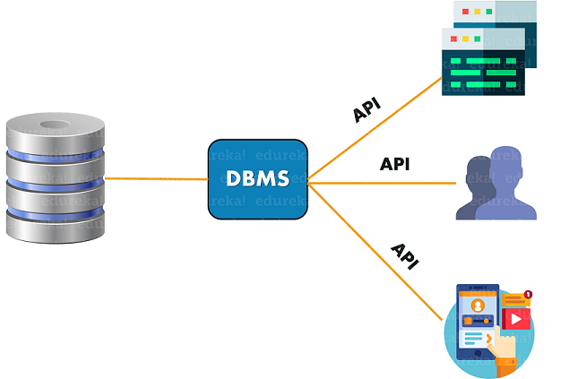





Problem Solving
Part - A

Slide 6

1. Create Database BANK And Write SQL Query To Create Above Schema With Constraints
CREATE DATABASE dbms_project1;
USE dbms_project1;
Part-1. CREATE TABLE BRANCH
CREATE TABLE branch(
branch_no INT AUTO_INCREMENT ,
name CHAR(50) NOT NULL
PRIMARY KEY (branch_no) );
Part-2. CREATE TABLE EMPLOYEES
CREATE TABLE employees(
emp_no INT AUTO_INCREMENT,
branch_no INT,
fname CHAR(20),
mname CHAR(20),
lname CHAR(20),
dept CHAR(20),
desig CHAR(10),
mngr_no INT NOT NULL,
PRIMARY KEY (emp_no),
FOREIGN KEY (branch_no) REFERENCES branch (branch_no));

Slide 7

Part-3. CREATE TABLE accounts
CREATE TABLE accounts(
acnumber INT,
custid INT,
branch_no INT,
curbal INT,
atype CHAR(10),
opndt DATE,
astatus CHAR(10),
PRIMARY KEY (acnumber),
FOREIGN KEY (custid) REFERENCES customers(custid),
FOREIGN KEY (branch_no) REFERENCES branch(branch_no));
Part-4. CREATE TABLE customers
CREATE TABLE customers(
custid INT AUTO_INCREMENT,
fname CHAR(30),
mname CHAR(30),
lname CHAR(30),
occupation CHAR(10),
dob DATE,
PRIMARY KEY (custid));

Slide 8
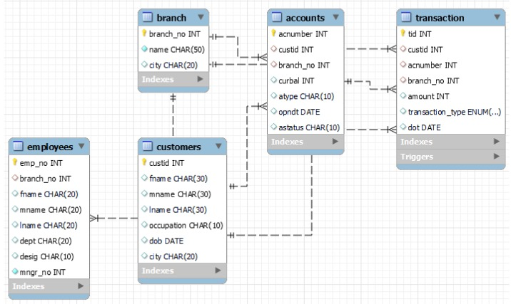
ER DIAGRAM

Slide 9




2. Inserting Records Into Created Tables
INSERT INTO branch VALUES (1, 'Delhi'), (2, 'Mumbai’);
INSERT INTO customers VALUES
(1,'Ramesh','Chandra', 'Sharma', 'Service', '1976-12-06’),
(2,'Avinash','Sunder', 'Minha', 'Business', '1974-10-16’);
INSERT INTO employees VALUES
(1, 1, 'Mark','Steve', 'Lara', 'Account', 'Accountant', 2),
(2, 2, 'Bella','James', 'Ronald', 'Loan', 'Manager', 1);
INSERT INTO accounts VALUES
(1, 1, 1, 100000, 'Saving', '2012-12-15','Active’),
(2, 2, 2, 5000, 'Saving', '2012-06-12','Active');

Slide 10



3. Select Unique Occupation From Customer Table
SELECT DISTINCT occupation FROM customers;
4. Sort Accounts According To Current Balance
SELECT * FROM accounts ORDER BY curbal ASC;
5. Find The Date Of Birth Of Customer Name ‘Ramesh’
SELECT dob FROM customers WHERE fname
LIKE 'Ramesh';

Slide 11



6. Add Column City To Branch Table
ALTER TABLE branch ADD COLUMN city CHAR(20);
SELECT * FROM branch;
7. Update the mname and lname of Employee ‘Bella’ and set to ‘Karan’, ‘Singh’
UPDATE employees
SET mname = 'Karan', lname = 'Singh’
WHERE fname LIKE 'Bella’ ;
8. Select Accounts Opened Between '2012-07-01' AND '2013-01-01'
SELECT acnumber FROM accounts
WHERE opndt BETWEEN '2012-07-01' AND '2013-01-01’;

Slide 12



9. List The Names Of Customers Having ‘A’ As The Second Letter In Their Names
SELECT fname, mname, lname FROM customers WHERE fname LIKE ‘_a ;
10. Find The Lowest Balance From Customer And Account Table
SELECT cust.custid, cust.fname, cust.mname, cust.lname, acc.curbal
FROM customers AS cust
INNER JOIN accounts acc
USING (custid)
ORDER BY curbal ASC LIMIT 1;
11. Give The Count Of Customer For Each Occupation
SELECT Occupation, COUNT(*) AS No_Of_Customers FROM Customers GROUP BY Occupation;

Slide 13



12. Write A Query To Find The Name (First_name, Last_name) of the Employees Who Are Managers.
SELECT fname, lname, desig
FROM employees
WHERE desig LIKE 'manager’ ;
13. Select the details of the employee who work for department ‘loan’ or ‘credit’
SELECT *
FROM employees
WHERE dept LIKE 'Loan' OR 'Credit’ ;
14. List Name Of All Employees Whose Name Ends With A
SELECT fname, mname, lname
FROM employees
WHERE fname LIKE '%a’ ;

Slide 14


15. Write a query to display the customers number, customers firstname, account number for the customers' who are born after 15th of any month.
SELECT a.custid, a.fname, b.acnumber
FROM customers a
JOIN accounts b
ON a.custid = b.custid
WHERE DATE(dob) > 15;
16. Write a query to display the customers' number, customers' firstname, branch id and balance amount for people using JOIN
SELECT a.custid, a.fname, b.branch_no, b.curbal
FROM customers a
JOIN accounts b
ON a.custid = b.custid;

Slide 15
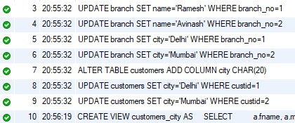

17. Create a virtual table to store the customers who are having the accounts in the same city as they live
Step-1 : Updating the data to execute query
UPDATE branch SET name='Ramesh' WHERE branch_no=1;
UPDATE branch SET name='Avinash' WHERE branch_no=2;
UPDATE branch SET city='Delhi' WHERE branch_no=1;
UPDATE branch SET city='Mumbai' WHERE branch_no=2;
ALTER TABLE customers ADD COLUMN city CHAR(20);
UPDATE customers SET city='Delhi' WHERE custid=1;
UPDATE customers SET city='Mumbai' WHERE custid=2;
Step-2 : Creating a view using the updated data
CREATE VIEW customers_city AS
SELECT a.fname, a.mname, a.lname, b.city
FROM customers a JOIN branch b
ON a.fname = b.name
WHERE a.city = b.city;
SELECT * FROM customers_city;
- customers_city view

Slide 16
18. Create a Transaction Table.
CREATE TABLE transaction
(tid INT AUTO_INCREMENT PRIMARY KEY,
custid INT,
acnumber INT,
branch_no INT,
amount INT,
transaction_type ENUM ('withdraw','deposit’),
dot DATE,
FOREIGN KEY (custid) REFERENCES customers(custid),
FOREIGN KEY (acnumber) REFERENCES accounts(acnumber),
FOREIGN KEY (branch_no) REFERENCES branch(branch_no));

Slide 17
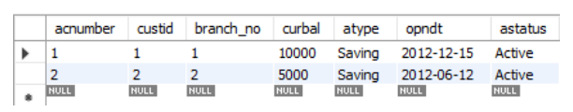
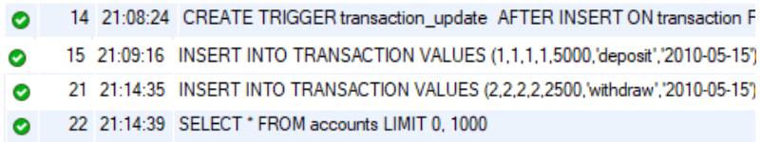
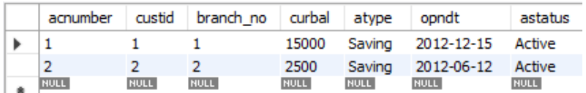
a. Write trigger to update balance in account table on Deposit or Withdraw in transaction table b. Insert values in transaction table to show trigger success
Part a:
DELIMITER //
CREATE TRIGGER transaction_update
AFTER INSERT ON transaction FOR EACH ROWBEGIN
UPDATE accounts SET curbal = curbal + NEW.amount * CASE
WHEN NEW.transaction_type ='withdraw’
THEN '-1’
ELSE '1’
END
WHERE custid=NEW.custid;
END
//DELIMITER ;
INSERT INTO TRANSACTION VALUES
(1,1,1,1,5000,'deposit','2010-05-15');
Account Table Before Update
Creating of Trigger and Inserting Values
Account Table Update After Trigger
Part b:

Slide 18
19. Write a query to display the details of customers with second highest balance
SELECT a.custid, a.fname, a.mname, a.lname, a.occupation, a.dob, b.acnumber, b.branch_no, b.atype, b.curbal AS balance, b.opndt, b.astatus
FROM customers a
JOIN accounts b
ON a.custid = b.custid
ORDER BY curbal DESC
LIMIT 1 OFFSET 1;
20. Take backup of the database created in this case study
To create a backup of the Database steps are:
SERVER -> EXPORT -> SELECT SCHEMA -> BROWSE LOCATION -> START EXPORT

Slide 19
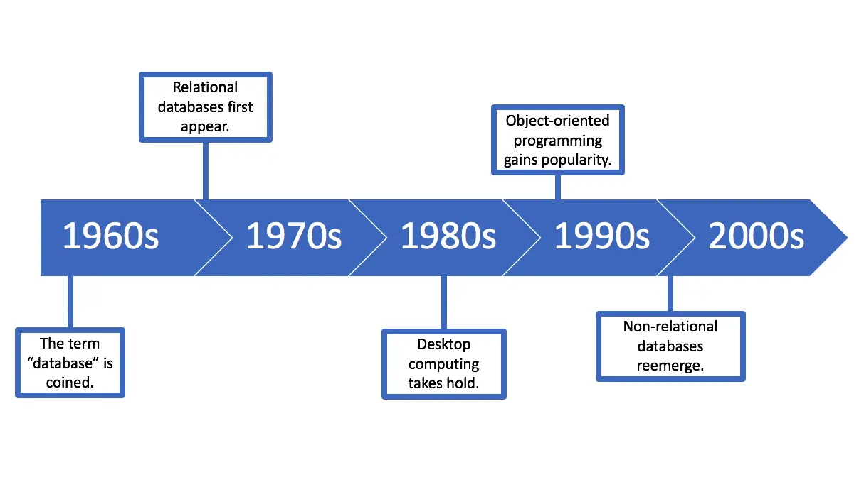
PART - B
PART - B

Slide 20
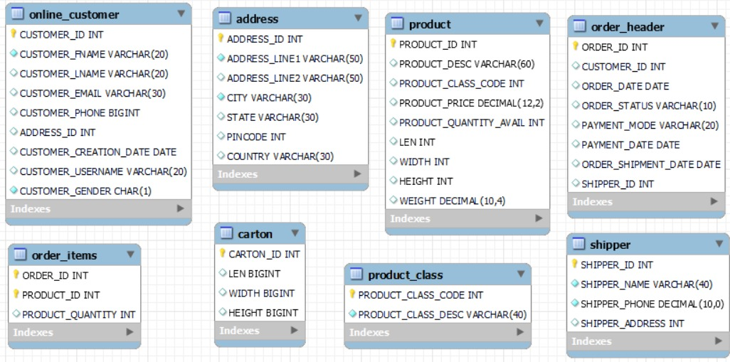
ER DIAGRAM

Slide 21
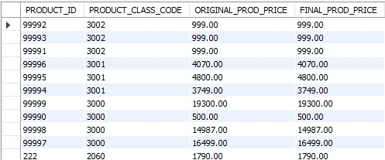
1. Display the Product Details as per the following Criteria and Sort them in Descending Order of Category:
If The Category Is 2050, Increase The Price By 2000
If The Category Is 2051, Increase The Price By 500
If The Category Is 2052, Increase The Price By 600
SELECT product_id, product_class_code,
product_price AS original_prod_price,
CASE
WHEN product_class_code = 2050 THEN product_price+2000
WHEN product_class_code = 2051 THEN product_price+500
WHEN product_class_code = 2052 THEN product_price+600
WHEN product_class_code > 2052 THEN product_price
END AS final_prod_price
FROM product ORDER BY product_class_code DESC;
*60 rows returned

Slide 22
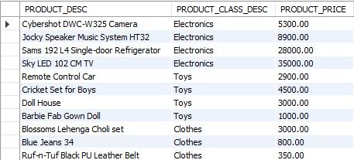
2. List the Product Description, Class Description And Price of All Products Which Are Shipped.
SELECT a.product_desc, b.product_class_desc, a.product_price
FROM product AS a
JOIN product_class AS b
ON a.product_class_code = b.product_class_code
WHERE product_id IN
(SELECT product_id FROM order_items WHERE order_id IN
(SELECT order_id FROM order_header WHERE order_status LIKE 'Shipped’ ) ) ;
*47 rows returned

Slide 23
3. Show Inventory Status Of Products As Below As Per Their Available Quantity:
A. For Electronics And Computer Categories,
If Available Quantity is: < 10, 'Low Stock’,
11 < qty < 30, 'In Stock’,
> 31, 'Enough Stock’
B. For Stationery And Clothes Categories,
If qty < 20, 'Low Stock’,
21 < qty < 80, 'In Stock’,
> 81, 'Enough Stock’
C. Rest Of The Categories,
If qty < 15, 'Low Stock’,
16 < qty < 50, 'In Stock’,
> 51, 'Enough Stock’
For All Categories, If Available Quantity Is 0, Show 'Out Of Stock'.

Slide 24
SELECT a.product_id, a.product_class_code, b.product_class_desc, a.product_quantity_avail,
CASE
WHEN product_quantity_avail = 0 THEN 'Out of stock’
WHEN product_class_desc like 'electronics' or 'computer’ THEN
CASE
WHEN a.product_quantity_avail <= 10 THEN 'low stock’
WHEN a.product_quantity_avail > 10 AND a.product_quantity_avail <= 30 THEN 'in stock'
WHEN a.product_quantity_avail > 31 THEN 'enough stock'
END
WHEN product_class_desc like 'stationery' or 'clothes’ THEN
CASE
WHEN a.product_quantity_avail <= 20 THEN 'low stock’
WHEN a.product_quantity_avail > 20 AND a.product_quantity_avail <= 80 THEN 'in stock' WHEN a.product_quantity_avail > 80 THEN 'enough stock’
END
ELSE CASE
WHEN a.product_quantity_avail <= 15 THEN 'low stock’
WHEN a.product_quantity_avail > 15 AND a.product_quantity_avail <= 50 THEN 'in stock’
WHEN a.product_quantity_avail > 50 THEN 'enough stock’
END
END AS inventory_status
FROM product AS a JOIN product_class AS b
ON a.product_class_code = b.product_class_code
ORDER BY product_id;

Slide 25
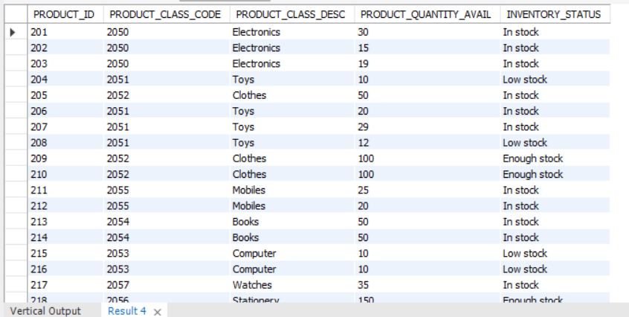
*60 rows returned

Slide 26
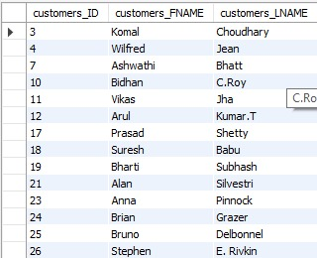
4. List Customers From Outside Karnataka Who Haven’t Bought Any Toys Or Books
SELECT customers_id, customers_fname, customers_lname FROM online_customers
WHERE address_id IN (SELECT address_id FROM address WHERE STATE NOT LIKE 'Karnataka’)
AND customers_ID IN (SELECT customers_ID FROM order_header WHERE order_id IN
(SELECT order_id FROM order_items WHERE product_id IN
(SELECT product_id FROM product WHERE product_class_code IN
(SELECT product_class_code FROM product_class WHERE product_class_desc NOT LIKE 'Toys' OR 'Books’ ) ) ) ) ;
*22 rows returned

Slide 27
FUTURE STEPS
In the future, we can enhance the project by using transactional commands (TCL) to set a limit for each user and grant access to only authorized individuals. This will help us to ensure that only the appropriate individuals have access to the database, which will enhance the security and privacy of the system.
Furthermore, we can prevent loss of data and maintain the atomicity of the data by using rollback and commit commands. This will ensure that if any error occurs during a transaction, the data changes can be rolled back to their previous state, preventing data loss.
Additionally, we can isolate tables before inserting or updating using various isolation levels such as read uncommitted, read committed, repeatable read, and serializable. This will prevent conflicts and ensure that the data remains consistent and accurate throughout the transaction.
Overall, these future steps will help to enhance the security, privacy, and reliability of the database, making it a more robust and effective system.

Slide 28

CONCLUSION
The objective of this report is to document the process of creating tables for data in the Bank Retail Case Study and inserting records into those tables while maintaining data integrity. This includes ensuring that all data entered into the tables conforms to the defined data types and constraints, and that all relationships between the tables are accurately established.
In this project, we have created separate tables for each entity - customer, employee, and account - and integrated them through referential integrity. We ensured data integrity in our database is accurately established. We have inserted few records into these tables and performed data retrieval using queries. This helped us fulfill some of the probable client-side requests from the database. Overall, the project was successful in achieving the objectives of creating and maintaining data integrity in the Bank Retail Case Study.
3.
One limitation of this project is that the database does not account for privacy concerns. The database contains sensitive information such as customer and employee details, which may not be suitable for unrestricted access. To overcome this limitation, we can create multiple views for each table and use those views to fetch records, which will reduce the access of the user towards the data. By using views, we can ensure that only the authorized individuals have access to the data that they require. This will enhance the privacy and security of the database and protect
sensitive information from unauthorized access.

Slide 29
THANK YOU

